Slide 1

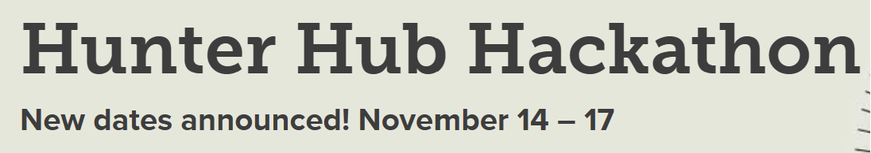

Slide 2

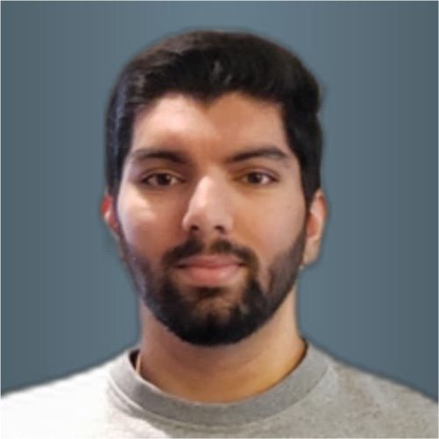
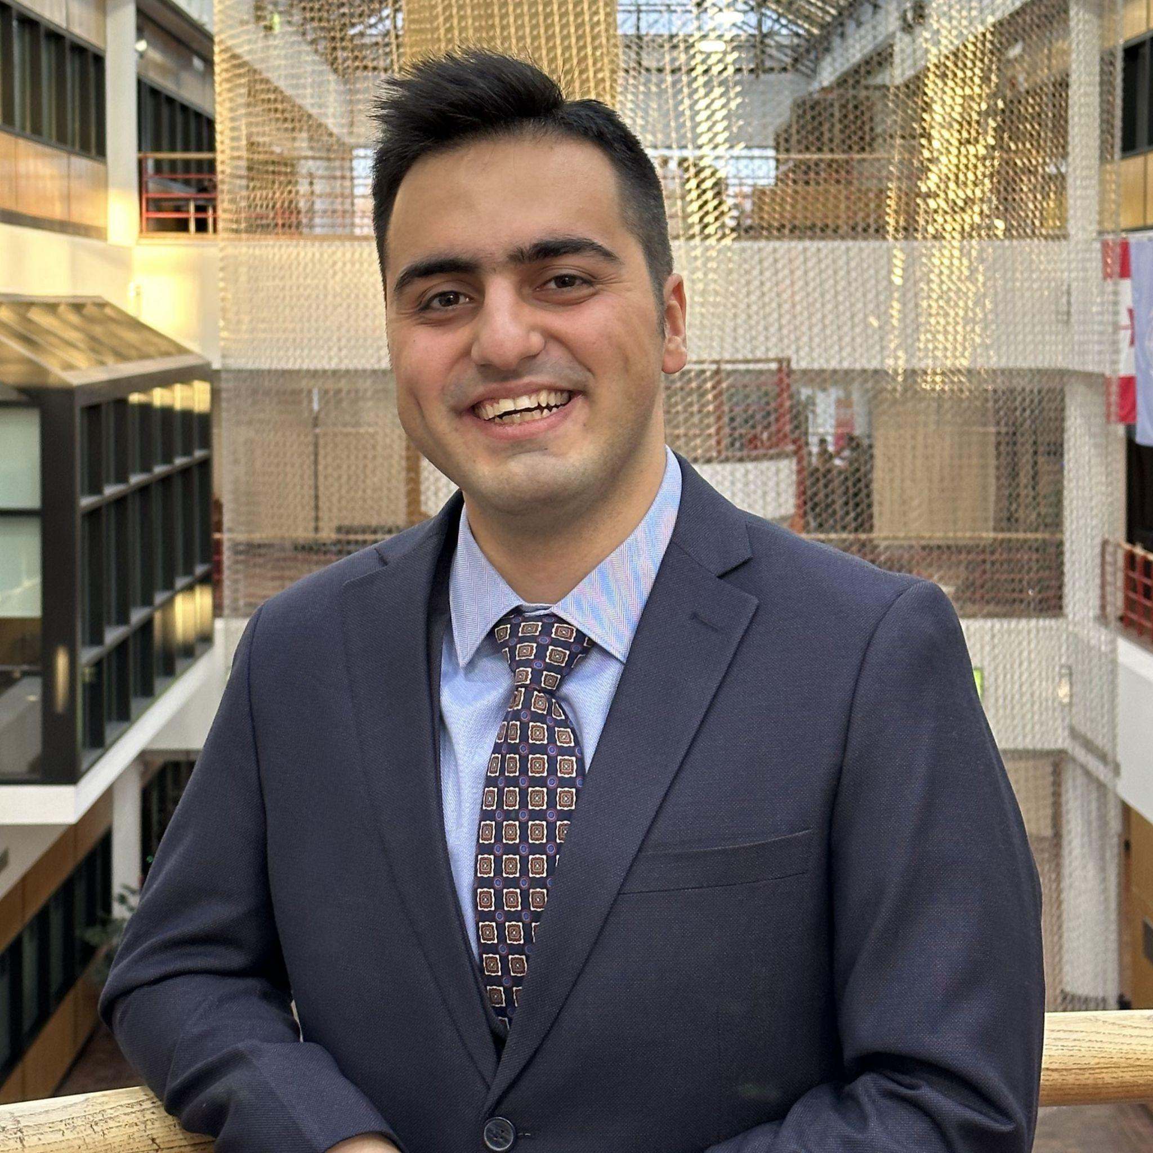
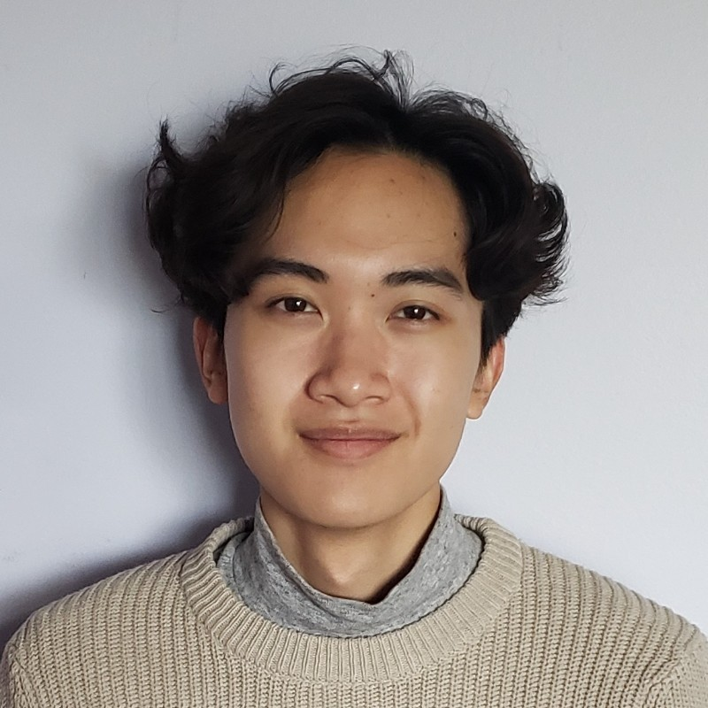
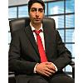
Our Team
Abhay Khosla
Ahad Ali
Arian Haghighat
Major in Software Engineering
Software Engineering and Finance Student
Major in Finance with embedded certificate in entrepreneurship
Jacob Lansang
Mushtaba Al Yasseen
Major in Software Engineering and Minor in Mechatronics Engineering
Software Engineering & Finance Student

Slide 3
Table of Contents
1
3
2
4
NLP
Chat Bot
Recommendations
Summarizer + Flash Cards

Slide 4



NLP
Enhanced Privacy
Reduced Dependency on ChatGPT
Great Learning Experience!
Notes:
The chatbot elevates its functionality by integrating SpaCy's large models in addition to ChatGPT, providing advanced natural language processing capabilities. This approach not only enhances data privacy through local processing but also reduces reliance on ChatGPT, fostering a more diverse and secure technological framework.

Slide 5
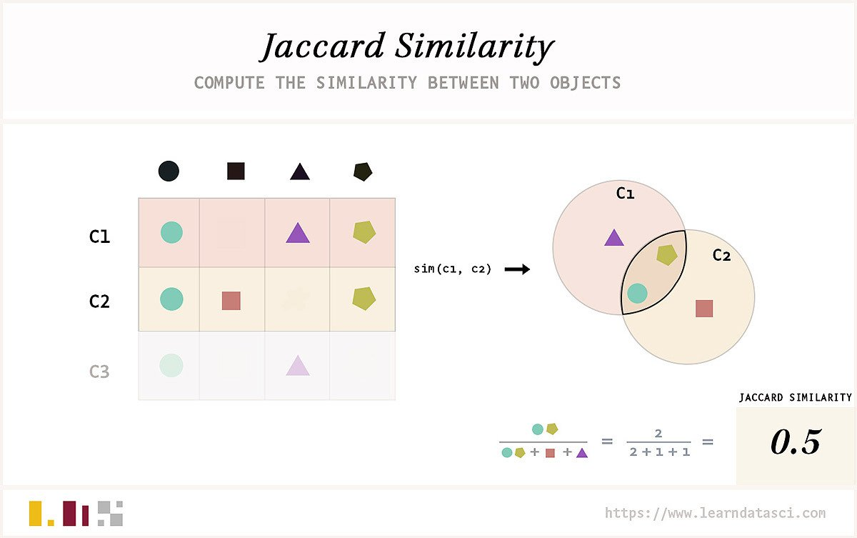



Recommendations
NLP PDF Extraction
Scholarship Recommendation using Jaccard Similarity
Top 10 Scholarships

Slide 6

Chat Bot
PDF Data Extraction
Essay Generation using Prompt Engineering
Interactive Environment

Slide 7
Summarizer/Flash Cards
Users can upload diverse documents such as lecture notes, slides, or papers (PDF Format).
The tool expertly condenses content into clear, concise summaries.
Perfect for students and professionals for efficient studying and comprehension.
Creates comprehensive flashcards to aid students in reinforcing their understanding

Slide 9
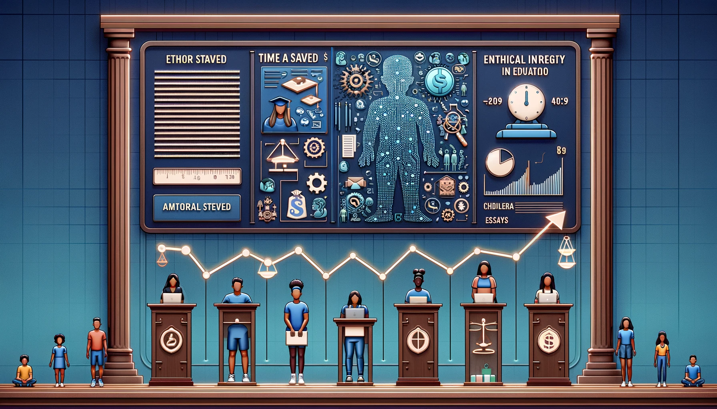
Social Impact

Slide 10


